Slide 1


EMOTION RECOGNITION USING CONVOLUTIONAL NEURAL NETWORKS (A STUDY ON HAPPY AND SAD IMAGE CLASSIFICATION)
PRESENTED BY: HARITHA P V
INTERN ID:MST03-0058
GUIDED BY: UROOJ KHAN

Slide 2
CONTENT
DEEP LEARNING
CONVOLUTIONAL NEURAL NETWORK
DATASET
MODEL ARCHITECTURE
TRAINING AND EVALUATION
RESULT
CONCLUSION

Slide 3

DEEP LEARNING
Deep learning utilizes neural networks with many layers to model complex patterns in data.
Deep learning is widely used in various fields such as computer vision, natural language processing, and autonomous systems.
The image classification model is developed and trained using the TensorFlow framework.
The high-level interface for building and training the CNN is provided by TensorFlow's Keras API.

Slide 4
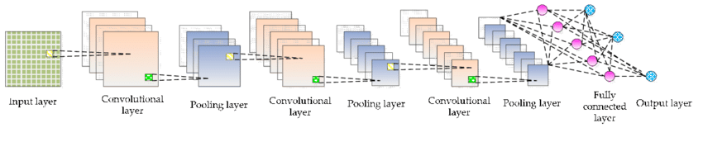
CNN (Convolutional Neural Network)
CNNs are designed to automatically and adaptively learn spatial hierarchies of features from input images.
Convolutional layers extract features from images by applying filters to detect patterns.
Pooling layers reduce dimensionality and computational complexity while retaining important features.
Fully connected layers classify the image based on the features learned from the convolutional layers.
Overview of CNN

Slide 5

DATASET
The dataset consists of images categorized into 'Happy' and 'Sad' classes.
The dataset includes various image file formats such as .jpg, .jpeg, .png, .bmp, .webp, .gif, and .tiff.
Images were resized to a uniform size of 256x256 pixels suitable for input into the Convolutional Neural Network (CNN).
Applied normalization to scale pixel values to the range [0, 1].

Slide 6
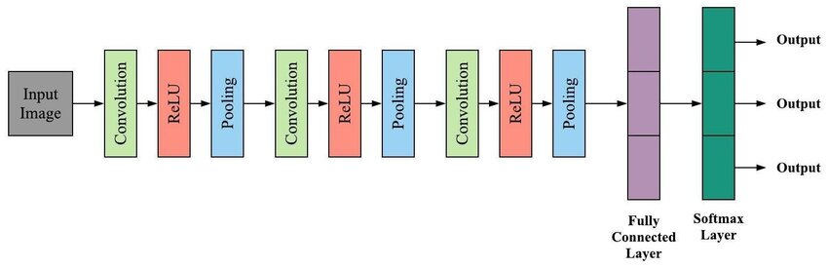
MODEL ARCHITECURE
The CNN model features four convolutional layers with an increasing number of filters to capture more complex patterns.
MaxPooling2D layers are applied after each convolutional layer to down sample the feature maps and reduce their dimensionality.
The 3D feature maps are converted into 1D vectors through flattening before being input into the dense layers.
The final dense layer uses a sigmoid activation function to output binary classification results.

Slide 7
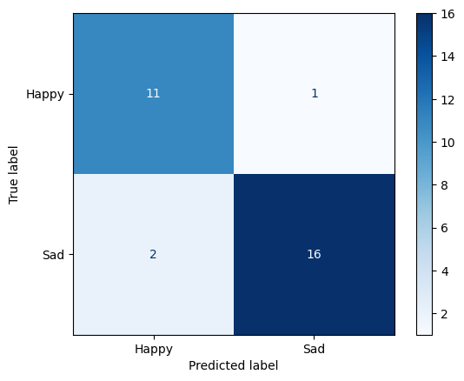
TRAINING AND EVALUATION
The model was trained for 20 epochs using the Adam optimizer and binary cross entropy loss.
A validation set was used to monitor the model's performance and prevent overfitting.
Assess model performance using precision, recall, and accuracy metrics on the test data.
Compute confusion matrix and classification report for detailed evaluation.
Confusion Matrix

Slide 8
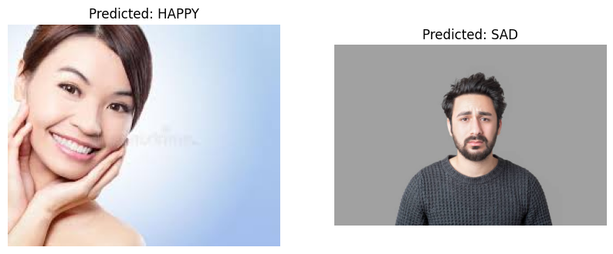
Fig: Predicted output
RESULT
The model effectively classifies images into "Happy" and "Sad" categories, demonstrating strong performance in distinguishing between these two emotional states.

Slide 9
CONCLUSION
Developed a CNN image classifier that achieved high accuracy in distinguishing 'Happy' vs. 'Sad' images.
Data preprocessing and model tuning were crucial for achieving optimal performance and accuracy.
The results demonstrated that the model effectively learned to distinguish between the two classes, achieving satisfactory accuracy.
The project highlights the effectiveness of deep learning frameworks like TensorFlow in solving image classification tasks and their potential in real-world applications.

Slide 10
THANK YOU

